Slide 1
Amazon Web Services
Amazon Web Services provides a highly reliable, scalable, low cost infrastructure platform in the cloud
AWS powers hundreds of thousands of business in 190 countries around the world.
AWS maintains its data centers in the U.S., Europe, Brazil, Singapore, Japan, and Australia
AWS provides compute power, storage, and other services in minutes and have the flexibility to choose the development platform or programming model
Users pay only for what they use, with no up-front expenses or long-term commitments

Slide 2
Benefits of AWS
Flexible
AWS enables to use various programming models, operating systems, databases, and architectures
Cost-effective
Pay only for what is used,
No up-front or long-term commitments.
Scalable and elastic.
Possible to add and subtract AWS resources to the applications to meet the demand and manage costs
Secure
AWS builds services in accordance with security best practices
Experienced
Organizations can leverage Amazon’s more than 25 years of experience in delivering large-scale, global infrastructure in a reliable, secure fashion.

Slide 3
AWS Products & Services
Compute
Amazon Elastic Compute Cloud(EC2)
Elastic Load Balancing
Auto Scaling
Amazon WorkSpaces
Analytics
Amazon Elastic MapReduce
Amazon Kinesis
AWS Data Pipeline
Content Delivery
Amazon Cloud Front

Slide 4
AWS Products & Services
Database
Amazon Rational database Service (Amazon RDS)
Amazon DinamoDB
Amazon RedShift
Amazon ElasticCache
Amazon SimpleBD
Storage
Amazon Simple Storage Service (S3)
Amazon Glacier
AWS Storage Gateway
Amazon Elastic Block Store (Amazon EBS)
AWS Import/Export

Slide 5
AWS Products & Services
Application Services
Amazon AppStream
Amazon CloudSearch
Amazon Simple Workflow Service (Amazon SWF)
Amazon Simple Queue Service (Amazon SQS)
Amazon Simple Notification Service (Amazon SNS)
Amazon Simple Email Service (Amazon SES)
Amazon Elastic Transcoder
Payments and billing
Amazon Flexible Payment Service (FPS)
Amazon DevPay

Slide 6
AWS Products & Services
Support
AWS support
Web Traffic
Alexa Web Information Service, Alexa Top Sites
Workforce
Amazon Mechanical Turk
Deployments and Management
AWS Identity and Access Management, Amazon CloudWatch, AWS CloudTrail, AWS Elastic BeanStalk, AWS CloudFormation, AWS CloudHSM, AWS OpsWorks
Software
AWS Marketplace
Networking
Amazon Route 53, AWS Direct Connect, Amazon Virtual private Cloud (VPC)

Slide 7
What is Amazon S3?
S3 = Simple Storage Service
A SOA which provides online storage using web services.
Allows read, write, and delete permissions on objects
Uses REST and SOAP protocols for messaging, so you can use various development toolkits with S3.

Slide 8

Amazon S3 is… Simple
Data Storage in Amazon Data Center
Web Service interface
No set-up fee, No monthly minimum
Storage: $0.15 per GB/Month
Data Transfer: $0.20/GB to transfer data
Private and public storage
Each object up to 5GB in size

Slide 9
Amazon S3
Amazon S3 is storage for the Internet. It is designed to make web-scale computing easier for developers.
Amazon S3 provides a simple web services interface that can be used to store and retrieve any amount of data, at any time, from anywhere on the web. The container for objects stored in Amazon S3 is called an Amazon S3 bucket. Amazon S3 gives any developer access to the same highly scalable, reliable, secure, fast, inexpensive infrastructure that Amazon uses to run its own global network of websites.

Slide 10
Amazon S3 Namespace
Amazon S3
bucket
bucket
object
object
object
object
bucket
object
object

Slide 11
Amazon S3 - Components
Objects
The information you're storing.
Consist of
metadata
System Metadata – Request ID Headers, useful for Amazon staff
User Metadata - 2kb Max. Date last modified, file size, or anything else you would like.
Data (5GB Max)‏
Objects are the fundamental storage entities in S3. They are composed of object data and metadata, and range in size from 1 byte to 5 gigabytes.
Metadata is a set of name-value pairs associated with the object. Default metadata includes date last modified, and standard metadata such as Content-Type. Custom metadata can be specified at the time the object is stored.

Slide 12
Amazon S3 - Components
Buckets
Container.
Each object is inside of a container.
Buckets are owned by an AWS account
http://mybucket.s3.amazonaws.com
If you have a file called hi.txt in the above bucket, it would be stored in http://mybucket.s3.amazonaws.com/hi.txt
A bucket is a container for objects. Every object is contained within a bucket.
The bucket provides a unique namespace for management of objects contained in the bucket.
No limit on the number of objects per bucket.
Bucket namespace is global. Each user is limited to 100 buckets.

Slide 13
Amazon S3 - Components
Keys
Files are represented as unique keys within a bucket.
In reality the key is basically your file name
Example: http://bucket.s3.amazonaws.com/file.txt
file.txt is the unique key
A key is a unique identifier for an object within a bucket. Every object has exactly one key.
The bucket name + key uniquely identify each object.
The full unique address for each object consists of service endpoint + bucket name + key. Example: “http://s3.amazonaws.com/testbucket/2006-09-30/photo.jpg”, where “testbucket” is the name of the bucket, and “2006-09-30/photo.jpg” is the name of thekey.

Slide 14
Authentication in AWS S3
Most requests to S3 require authentication to verify that the requestor is authorized to perform the requested action. If the owner of an object has specifically granted anonymous access to an object or bucket, then authentication isn’t required.
When you register for S3, you will be provided with a AWS Access Key ID and a AWS Secret Access Key.
To authenticate a request, the following authentication information is included in the SOAP request:
AWSAccessKeyId
Timestamp
Signature: The HMAC-SHA1 digest of the concatenation of “Amazon S3 + OPERATION + Timestamp”, using your AWS Secret Key as the signing key.

Slide 15
Amazon S3 - Operations
Use either the REST or SOAP API to do the following and more
Create a bucket
Write an object
Read an object
Delete an object (Be careful not to rapidly create and delete an object)‏
List the keys (files)‏

Slide 16
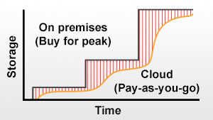
S3 and EBS for Your Storage Needs
Amazon S3 – Object Storage
Highly scalable, high performance.
Can access directly from the internet.
Integrates with CloudFront (CDN).
Perfect for back-up and archiving.
Amazon EBS -- Block Storage
Snapshotting – long term durability.
Provisioned IOPS or Standard volumes.
Amazon Glacier -- Archive Storage
Extremely low-cost optimized for infrequent access.

Slide 17
Simple DB in a Nutshell
Simple DB Domain
Idea:
Create flat database with
auto-indexed tables.
Record 1
Key1
Attributes: A1,A2…
…
Record N
Main Features:
Each attribute is indexed.
Record structure is flexible.
Basic operators in queries
Supports sorting.
Key2
Attributes: A1,A2…
Get record
Query records
Put record
Client

Slide 18
Sample SimpleDB Use Cases
Index Media files stored on S3
Use the same key as on S3
Write the record with each metadata element as attribute
Store flat objects
Use SimpleDB as a storage for non-nested data

Slide 19
Amazon EC2 Is…
A Web service that provides resizable compute capacity in the cloud.
Designed to make Web-scale computing easier for developers.
A simple Web service interface that provides complete control of your computing resources

Slide 20
Amazon EC2 Benefits You Because It
Reduces the time required to obtain and boot new server instances to minutes
Quickly scales capacity, both up and down, as your computing requirements change
Changes the economics of computing:
Pay only for capacity that you actually use
a + bc becomes just bc

Slide 21
Amazon EC2 Changes Computing Economics
No start-up, monthly, or fixed costs
$0.10 per CPU hour
$0.20 per GB transferred across Net
No cost to transfer data between Amazon S3 and Amazon EC2

Slide 22
Amazon EC2
EC2 provides web services API for provisioning, managing, and deprovioning virtual servers inside amazon cloud.
Applications anywhere on the Internet can launch a virtual server in the amazon cloud with a single web services call (either REST or SOAP WS call)
Where is SOAP API? For example, http://docs.amazonwebservices.com/AmazonEC2/dg/2006-06-26/using-soap-api.html

Slide 23
Amazon Elastic Block Store
Amazon Elastic Block Store (EBS) provides block level storage volumes for use with Amazon EC2 instances. Amazon EBS volumes are network-attached, and persist independently from the life of an instance.
Amazon EBS provides highly available, highly reliable, predictable storage volumes that can be attached to a running Amazon EC2 instance and exposed as a device within the instance.
Amazon EBS is particularly suited for applications that require a database, file system, or access to raw block level storage.

Slide 24
EC2 instances
A virtual computing environment with a web interface.
Create and configure an “instance” (Amazon Machine Image)
Example: Extra large instance (standard)
15GB of memory
8 EC2 Compute Units (4 virtual cores)
1690GB of local storage
64 bit platform
Also offers cluster compute instances
Example
Cluster Compute Eight Extra large with 60GB memory, 88 EC2 units, 3370 local storage, 64-bit platform, 10 Gigabit Ethernet.

Slide 25
AMI and instances
Amazon Machine Image (AMI):
Bootable, pre-defined or user-built
OS: Fedora, Centos, Gentoo, Debian, Ubuntu, Windows Server
Software packages: LAMP, mpiBLAST, Hadoop
Instance:
Running copy of an AMI
Launch in less than 2 minutes
Start/stop programmatically

Slide 26
Amazon Simple Queue Services
Amazon SQS is a distributed queue system that enables web service applications to quickly and reliably queue messages that one component in the application generates to be consumed by another component.
A queue is a temporary repository for messages that are awaiting processing.
The queue acts as a buffer between the component producing and saving data, and the component receiving the data for processing.

Slide 27
Amazon Simple Queue Services
A reliable, highly scalable hosted distributed queue for storing messages as they travel between computers.
Amazon's web-scale messaging infrastructure as a web service
Platform-agnostic, allowing any computer on the Internet to add or read messages without any installed software or special firewall configurations

Slide 28
Amazon Simple Queue Service
Amazon Simple Queue Service (Amazon SQS) is a fast, reliable, scalable, fully managed message queuing service.
SQS makes it simple and cost-effective to decouple the components of a cloud application. You can use SQS to transmit any volume of data, at any level of throughput, without losing messages or requiring other services to be always available.
With SQS, you can offload the administrative burden of operating and scaling a highly available messaging cluster, while paying a low price for only what you use.

Slide 29
Amazon Simple Queue Service
Preparing the Samples
Creating a queue
Confirming the Queue Exists
Sending a message to a queue
Retrieving messages from a queue
Deleting a message from a queue

Slide 30
Amazon SQS Highlights
Reliable
Runs within Amazon's high-availability data centers.
Messages are stored redundantly across multiple servers and data centers.
Simple: Only Six Methods
Scalable
Secure: Strong access controls

Slide 31
Amazon SQS Pricing
Pay only for what you use
No minimum fee
No start-up cost
$0.10 per 1,000 messages sent ($0.0001 per message sent)
$0.20 per GB of data transferred

Slide 32
Amazon CloudFront
Amazon CloudFront is a content delivery web service. It integrates with other Amazon Web Services to give developers and businesses an easy way to distribute content to end users with low latency, high data transfer speeds, and no commitments.
Amazon CloudFront can be used to deliver your entire website, including dynamic, static and streaming content using a global network of edge locations. Requests for objects are automatically routed to the nearest edge location, so content is delivered with the best possible performance.
Amazon CloudFront is optimized to work with other Amazon Web Services, like Amazon S3 and Amazon EC2.
There are no contracts or monthly commitments for using Amazon CloudFront—you pay only for as much or as little content as you actually deliver through the service.

Slide 33
Amazon Cloud-front
Cloud-based content distributing network enables you to place the content at the edges of the network for rapid delivery.
Place the contents in S3 and run the application from anywhere and the content is moved to where the application is (to the edges).

Slide 34
SimpleDB data model details
• Domains
identified by a string (UTF-8)
100/account (beta)
10 GB/domain (beta)
Items
identified by a string (UTF-8)
unlimited number/domain
Attributes
name-value pair (both UTF-8)
type-less values, just strings; automatically indexed
256/item
250 mio./domain
1KB/attribute value

Slide 35
SimpleDB operations
Domains
CreateDomain
ListDomains
DeleteDomain
tems/Attributes
PutAttributes (store/change an item)
DeleteAttributes
GetAttributes (retrieve an item)
What is Missing?
No transaction, No notifications, No sorting, No joins, No data types

Slide 36
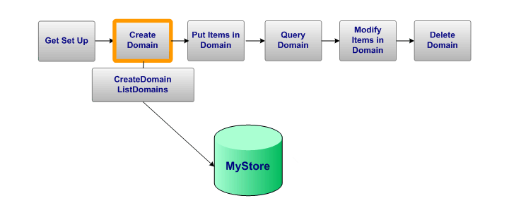
SimpleDB: Create Domain

Slide 37
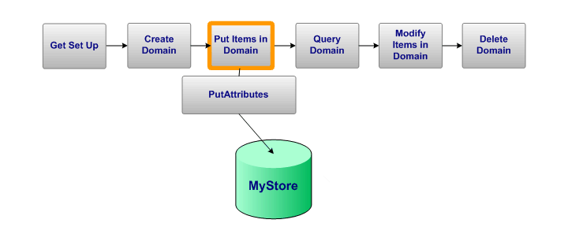
SimpleDB: Put Item in Domain

Slide 38
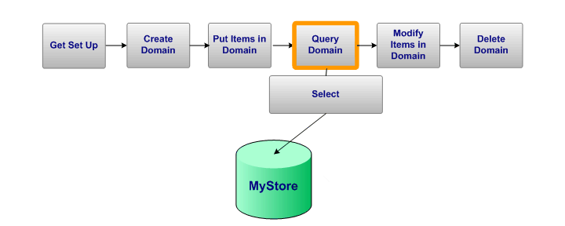
SimpleDB: Query Domain

Slide 39
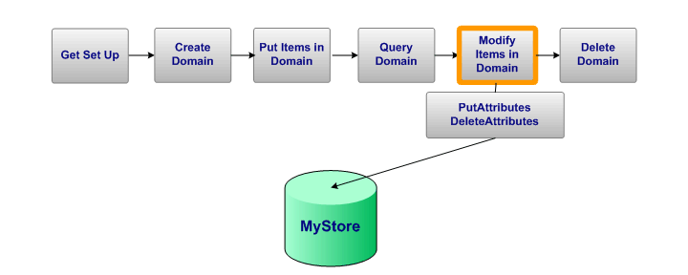
SimpleDB: Modify Items in Domain

Slide 40
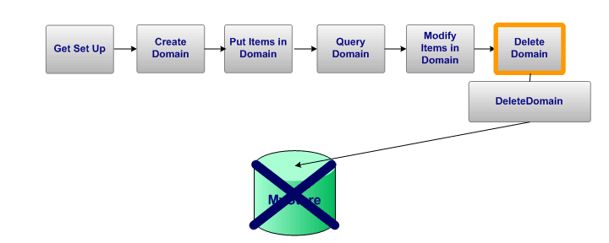
SimpleDB: Delete Domain

Slide 41
Amazon CloudFront
CloudFront is a web service that speeds up distribution of static and dynamic web content, for example, .html, .css, .php, and image files, to end users.
CloudFront delivers the content through a worldwide network of data centers called edge locations.
When a user requests content, the user is routed to the edge location that provides the lowest latency (time delay), so content is delivered with the best possible performance.
If the content is already in edge location with the lowest latency, CloudFront delivers it immediately.
If the content is not currently in that edge location, CloudFront retrieves it from an Amazon S3 bucket or an HTTP server (for example, a web server) that is identified as the source for the definitive version of the content.

Slide 42
Amazon Web Services

Slide 43
Amazon Web Services

Slide 44
Amazon Web Services

Slide 45
Amazon Web Services

Slide 46
Amazon Web Services

Slide 47
Amazon Web Services

Slide 48
Amazon Web Services

Slide 49
Amazon Web Services

Slide 50
AWS Cloud Application Design: 10 Best Practices
Build cloud apps, not apps in the cloud
Virtualize the application stack
Design for failure and nothing fails
Design for scalability
Loose coupling lets you maximize plug&play
Design for dynamism
Build Security into every component
Leverage native cloud storage options
Leverage best cloud Management Tools
Don't fear cloud constraints

Slide 51
Amazon Web Services
Elastic Compute Cloud – EC2 (IaaS)
Simple Storage Service – S3 (IaaS)
Elastic Block Storage – EBS (IaaS)
SimpleDB (SDB) (PaaS)
Simple Queue Service – SQS (PaaS)
CloudFront (S3 based Content Delivery Network – PaaS)
Consistent AWS Web Services API

Slide 52
Overview of Amazon Web Services
Officially launched in 2006.
Currently serving 100,000s of customers.
4 continents.
190 countries.
9 Regions, 25 Availability Zones, 45 Edge Locations.
40+ Products
283 significant improvements or new services in 2013.
Continually develop solutions that integrate into third-party and proprietary products.
Our number one priority is the customer.

Slide 53
An overview of AWS
AWS is Amazon’s umbrella description of all of their web-based technology services.
Mainly infrastructure services:
Amazon Elastic Compute Cloud (EC2)
Amazon Simple Storage Service (S3)
Amazon Simple Queue Service (SQS)
Amazon CloudFront
Amazon SimpleDB
Amazon EC2 is hiring
http://aws.amazon.com/ec2-jobs/

